Slide 1

Australia Int’l Trading report
Time series (1987 – 2019) Data visualization,
when, where to buy & sell, values.

Slide 2

Codding road MAP
Flask API tested
New JS function deployed
D3
GEOJSON
& JSON
JS
HTML
Leaflet
CSS
PostgreSQL
Pandas
Json
MongoDB
CSV Geojson

Slide 3
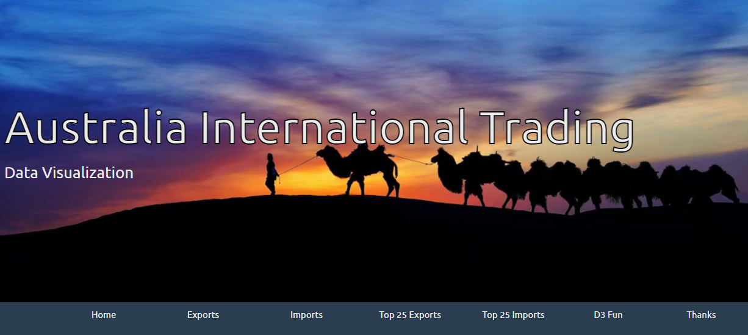
Index Page

Slide 4
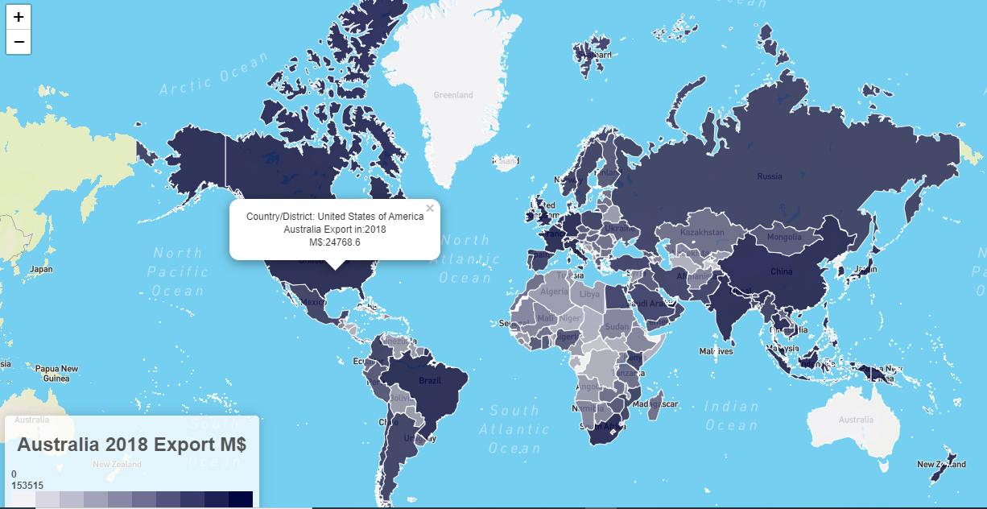
Export Chart for 2018

Slide 5
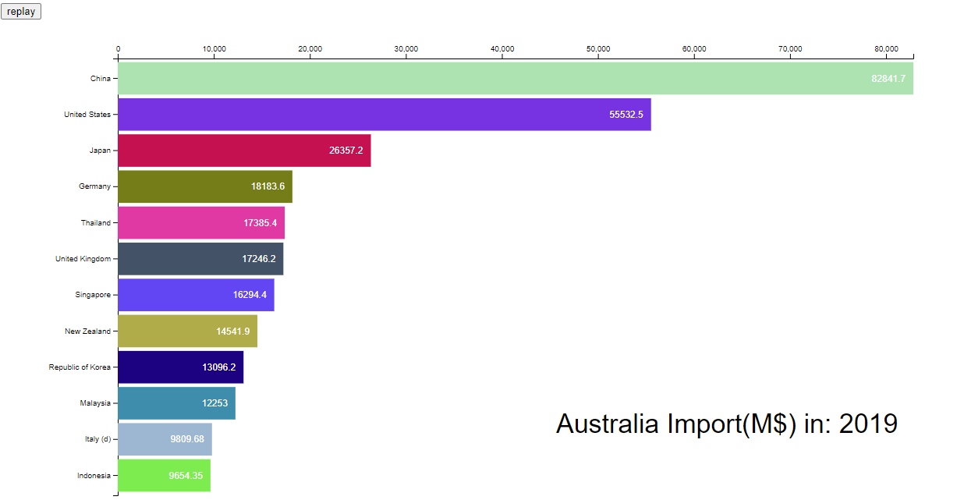
Import chart for 2019

Slide 6
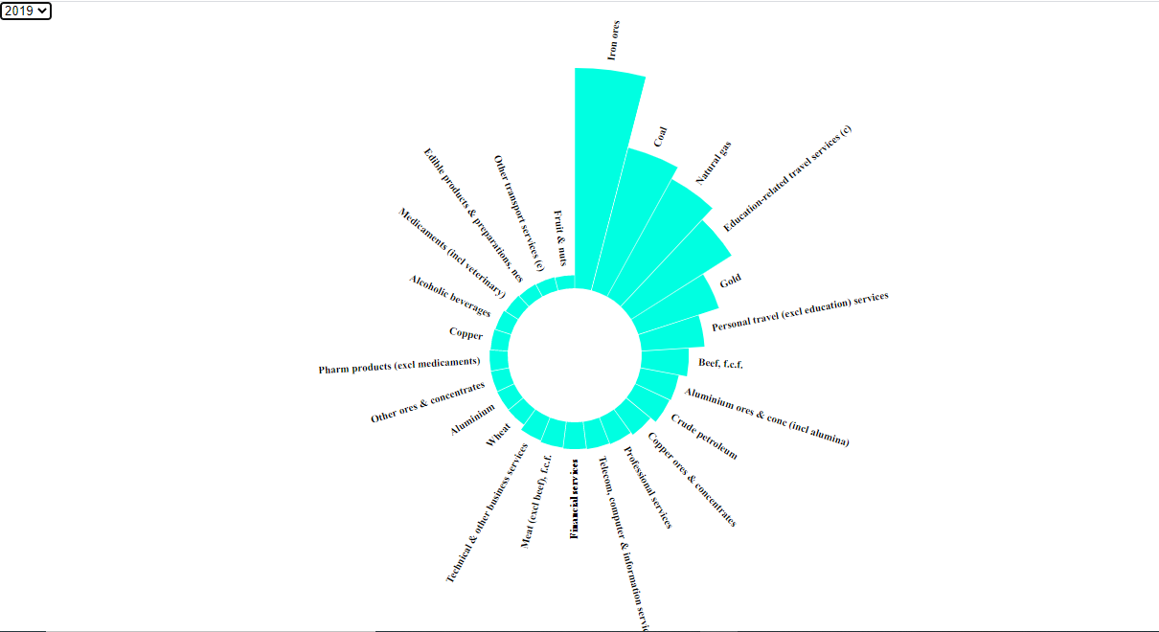
Top 25 export commodities 2019

Slide 7
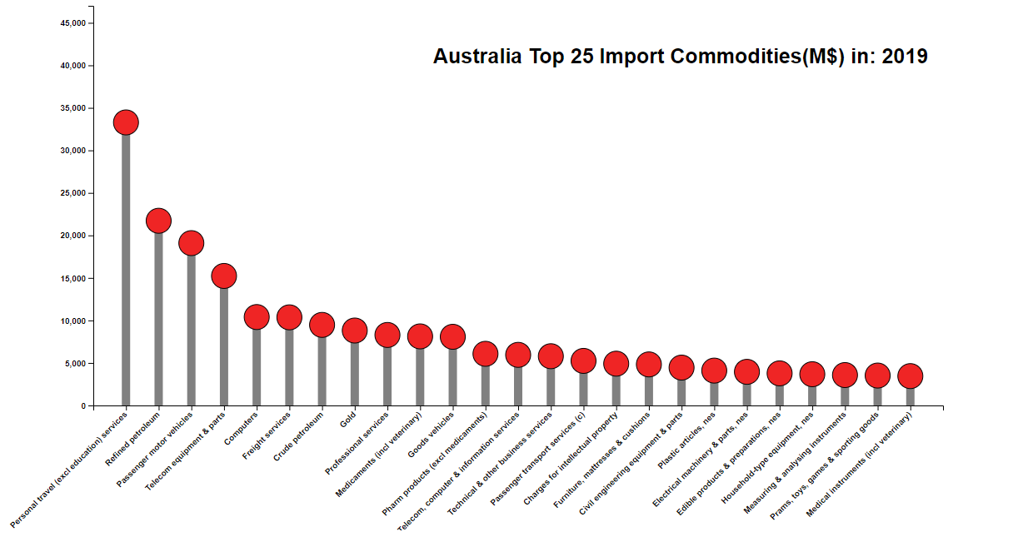
Top 25 import commodities

Slide 8

Thanks and question time

Slide 9


This is my projection 2, with DATA BOOT CAMP / UWA
Thank you very much for your attention & comments/questions.
Happy to answer your questions.
TONY
ZHAO
01/05/
2021

